Slide 1

Evaluating Low-Risk Aircraft Models for Commercial and Private Operations
Presented by: Lydia Mangoa
24th November 2024

Slide 2
Overview
Goal:
Identify low-risk aircraft models for commercial and private operations by analyzing historical aviation accident data.
Objectives:
Recognize accident patterns to minimize risk.
Evaluate design factors like engine configuration on safety.
Deliver actionable recommendations for informed fleet selection.

Slide 3
Business Understanding
Stakeholders:
Head of Aviation Division: Makes purchasing decisions and oversees aircraft selection and safety strategies.
Leadership Team: Focused on minimizing financial and operational risks and safeguard company reputation..

Slide 4
Business Understanding Cont…
Key Business Questions:
Which aircraft models offer the safest records for operation?
How does design (e.g., engine configuration) influence accident outcomes?
What historical trends should shape future decisions?
Why This Matters: Reducing operational risks and improving safety enhances the company’s reputation and ensures financial sustainability.

Slide 5
Data Understanding
Data Source:
The Kaggle Aviation Accident Database Synopses, a historical dataset with 88,889 records of aviation accidents.
Key Data Points:
Aircraft Models: Accident occurrences by type.
Engine Configuration: Safety implications of single vs. multi-engine aircraft.
Weather Conditions: Role of weather on accident frequencies.

Slide 6
Data Understanding
Challenges Addressed:
Data Completeness: Mitigating "unknown" classifications in weather data.
Consistency: Standardizing reporting variances.

Slide 7
Data Analysis
Visualization 1: Top 10 Aircraft Makes by Accident Count (Bar Chart)
Insight: High accident counts for some models (e.g., Cessna, Piper) may reflect widespread use rather than inherent risk.
Business Recommendation: Focus safety audits and maintenance efforts on these high-usage models

Slide 8
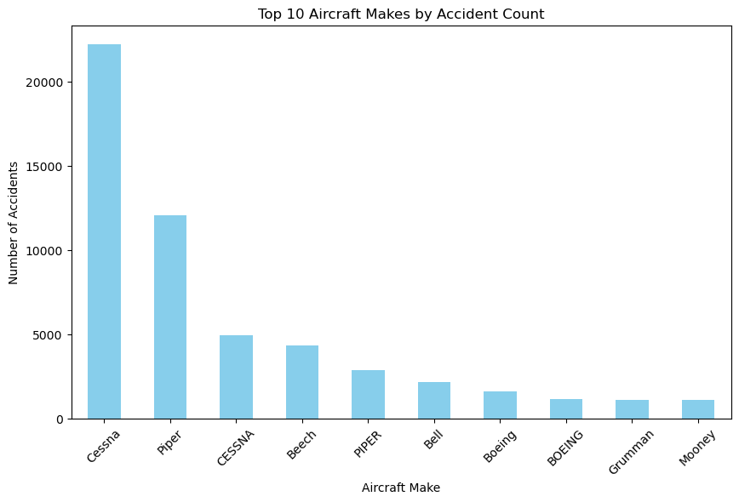

Slide 9
Data Analysis Cont…
Visualization 2: Yearly Trend in Aviation Accidents (Line Chart)
Insight: A declining trend in accidents since the 1980s, reflecting technological advancements and improved safety practices. Modern aircraft are safer due to enhanced navigation, automation, and design improvements.
Business Recommendation: Invest in newer aircraft models equipped with modern safety technologies, including automated navigation systems.

Slide 10
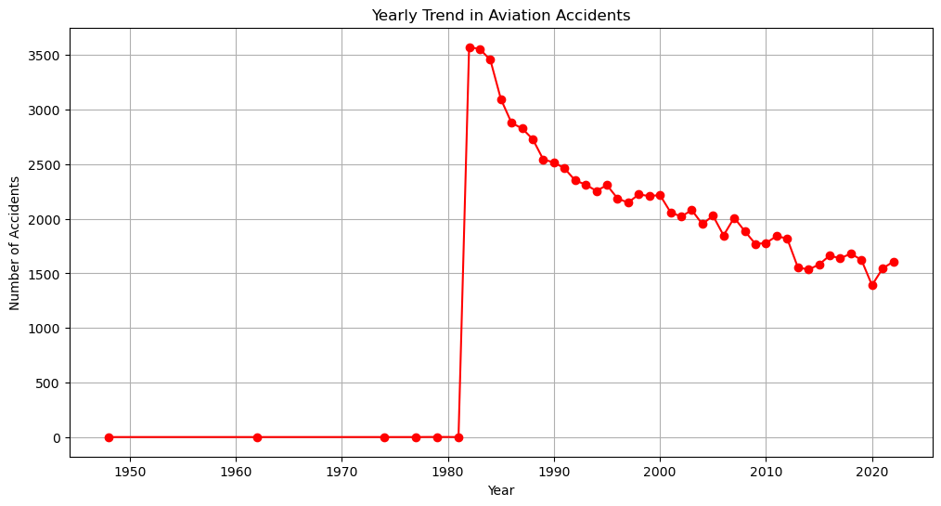

Slide 11
Data Analysis Cont…
Visualization 3: Fatality Rate by Number of Engines (Bar Chart)
Insight: Multi-engine aircraft have lower fatality rates than single-engine aircraft, emphasizing the safety of redundancy.
Business Recommendation: Prioritize multi-engine aircraft for high-stakes commercial operations.

Slide 12
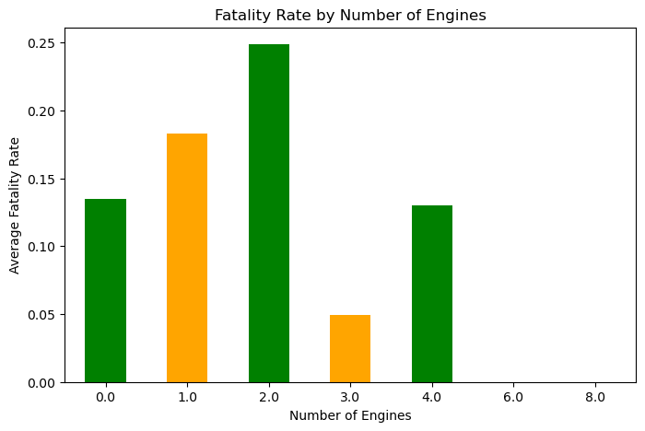

Slide 13
Recommendations
Focus on Proven Safe Models:
Select aircraft like modern iterations of Boeing and Airbus models with strong safety records.
Emphasize on Multi-Engine Aircraft:
Multi-engine redundancy enhances safety for high-stakes and commercial operations.
Invest in Technology:
Opt for aircraft with advanced weather detection and automation features.

Slide 14
Next Steps
Assess High-Usage Models: Conduct safety and reliability assessments for frequently used aircraft models.
Pilot Program for Multi-Engine Aircraft: Test the operational and financial performance of multi-engine aircraft in select routes.
Improve Safety Culture: Enhance training programs and maintenance schedules for high-usage aircraft and high risk phases like takeoff and landing.
Address Data Gaps: Collaborate with aviation authorities to improve weather and accident reporting standards.

Slide 15
Thank You. Q&A
Name: Lydia Mangoa
LinkedIn: http://www.linkedin.com/in/lydia-mangoa-2b5b68a8

